Slide 1
Decision Tree & Naive Bayes Questions

Slide 2
A Decision Tree Question
Here is a table which records some data about whether a student will go out to play. Use decision tree to analysis the following questions:
Which attribute you will choose as root node among outlook, temperature, humidity and windy?
(2) Write your analysis process in question (1).
(3) Draw the decision tree.

Slide 3
Entropy Review
Entropy is a measure of the uncertainty of a random variable; acquisition of information corresponds to a reduction in entropy.
$$H\left(V\right)=−\sum_{k}{P(v_{k})\log_{2}P(v_{k})}$$
the entropy of a fair coin flip :
$$H\left(Fair\right)=−{0.5∗log}_{2}^{0.5} −0.5∗\log_{2}^{0.5}=1$$

Slide 4
No:5
Yes:9
H(Play) = $−{\frac{9}{14}∗log}_{2}^{\frac{9}{14}} −\frac{5}{14}∗\log_{2}^{\frac{5}{14}}=0.940$

Slide 5
Information Gain
$H\left(Y | X\right)=\sum_{x∈X}{p\left(x\right)H(Y|X=x)}$
$IG\left(Y|X\right)=H\left(Y\right)− H(Y|X)$
 | YES | No | total
sunny | 2 | 3 | 5
overcast | 4 | 0 | 4
rain | 3 | 2 | 5
total | 9 | 5 | 14
outlook=sunny
outlook=overcast
outlook=rain
$$\frac{5}{14}∗\left(−\frac{2}{5}{∗log}_{2}^{\frac{2}{5}}−\frac{3}{5}{∗log}_{2}^{\frac{3}{5}}\right)+\frac{4}{14}∗\left(−\frac{4}{4}{∗log}_{2}^{\frac{4}{4}}−0{∗log}_{2}^{0}\right)+\frac{5}{14}∗\left(−\frac{3}{5}{∗log}_{2}^{\frac{3}{5}}−\frac{2}{5}{∗log}_{2}^{\frac{2}{5}}\right)$$
$H\left(play | outlook\right)$ =

Slide 6
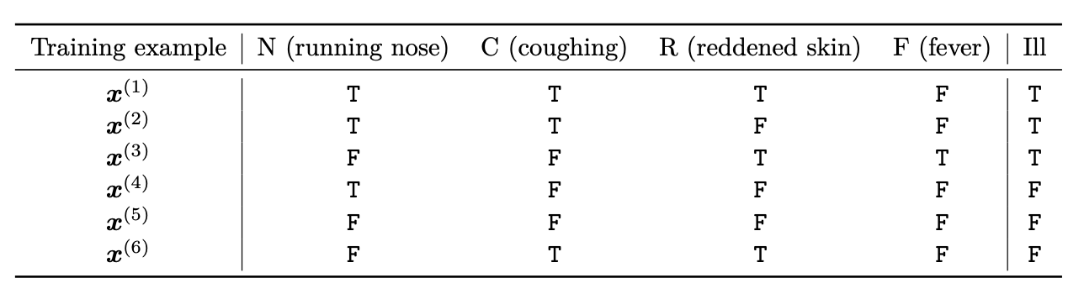
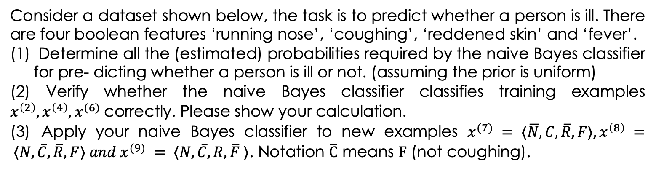
A Navie Bayes Question
Consider a dataset shown below, the task is to predict whether a person is ill. There are four boolean features ‘running nose’, ‘coughing’, ‘reddened skin’ and ‘fever’.
Determine all the (estimated) probabilities required by the naive Bayes classifier for pre- dicting whether a person is ill or not. (assuming the prior is uniform)
(2) Verify whether the naive Bayes classifier classifies training examples $x^{\left(2\right)},x^{\left(4\right)},x^{(6)}$correctly. Please show your calculation.
(3) Apply your naive Bayes classifier to new examples $x^{(7)} = ⟨\overline{N}, C, \overline{R}, F⟩, x^{\left(8\right)} = ⟨N, \overline{C}, \overline{R}, F⟩ and x^{(9)} = ⟨N, \overline{C}, R, \overline{F} ⟩$. Notation $\overline{C}$ means $F$ (not coughing).

Slide 7
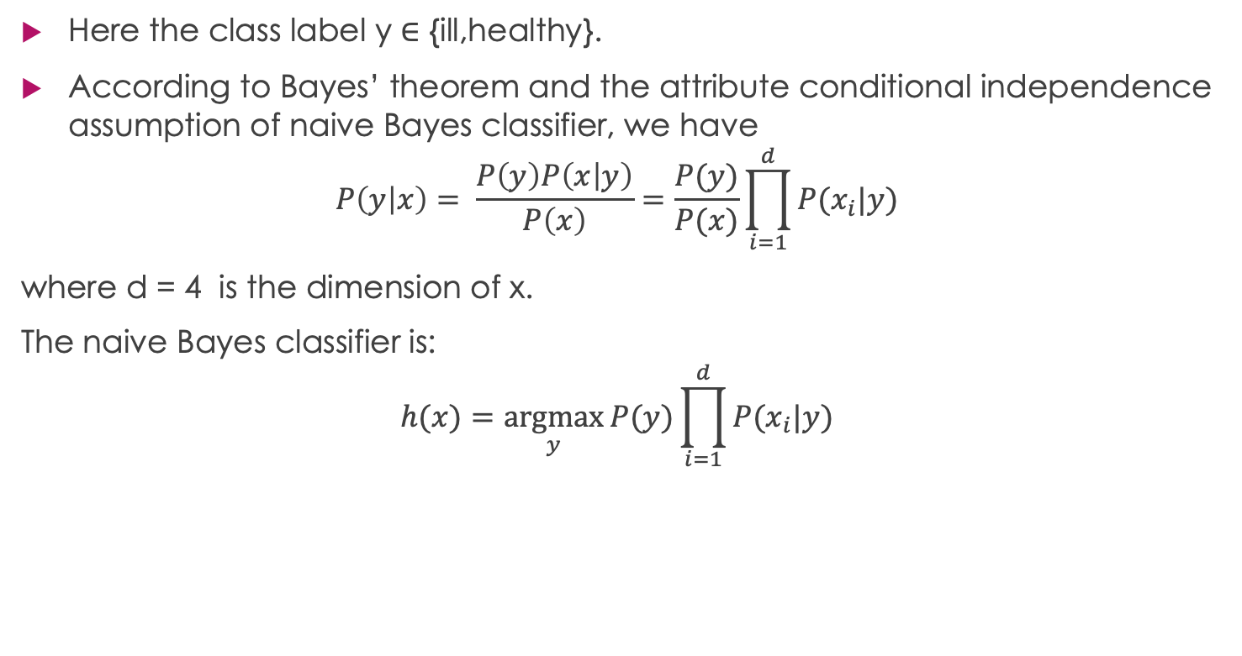
NBC Question Answer(1)
Here the class label y ∈ {ill,healthy}.
According to Bayes’ theorem and the attribute conditional independence assumption of naive Bayes classifier, we have
$$P\left(y | x\right)= \frac{P\left(y\right)P\left(x | y\right)}{P\left(x\right)}=\frac{P(y)}{P(x)}\prod_{i=1}^{d}{P(x_{i}|y)}$$
where d = 4 is the dimension of x.
The naive Bayes classifier is:
$$h(x)=\underset{y}{argmax}{P(y)}\prod_{i=1}^{d}{P(x_{i}|y)}$$

Slide 8








$$\frac{2}{3}$$
$$\frac{2}{3}$$
$$\frac{2}{3}$$
$$\frac{1}{3}$$
ill
$$\frac{1}{3}$$
$$\frac{1}{3}$$
$$\frac{1}{3}$$
$$\frac{0}{3}$$
healthy

Slide 9
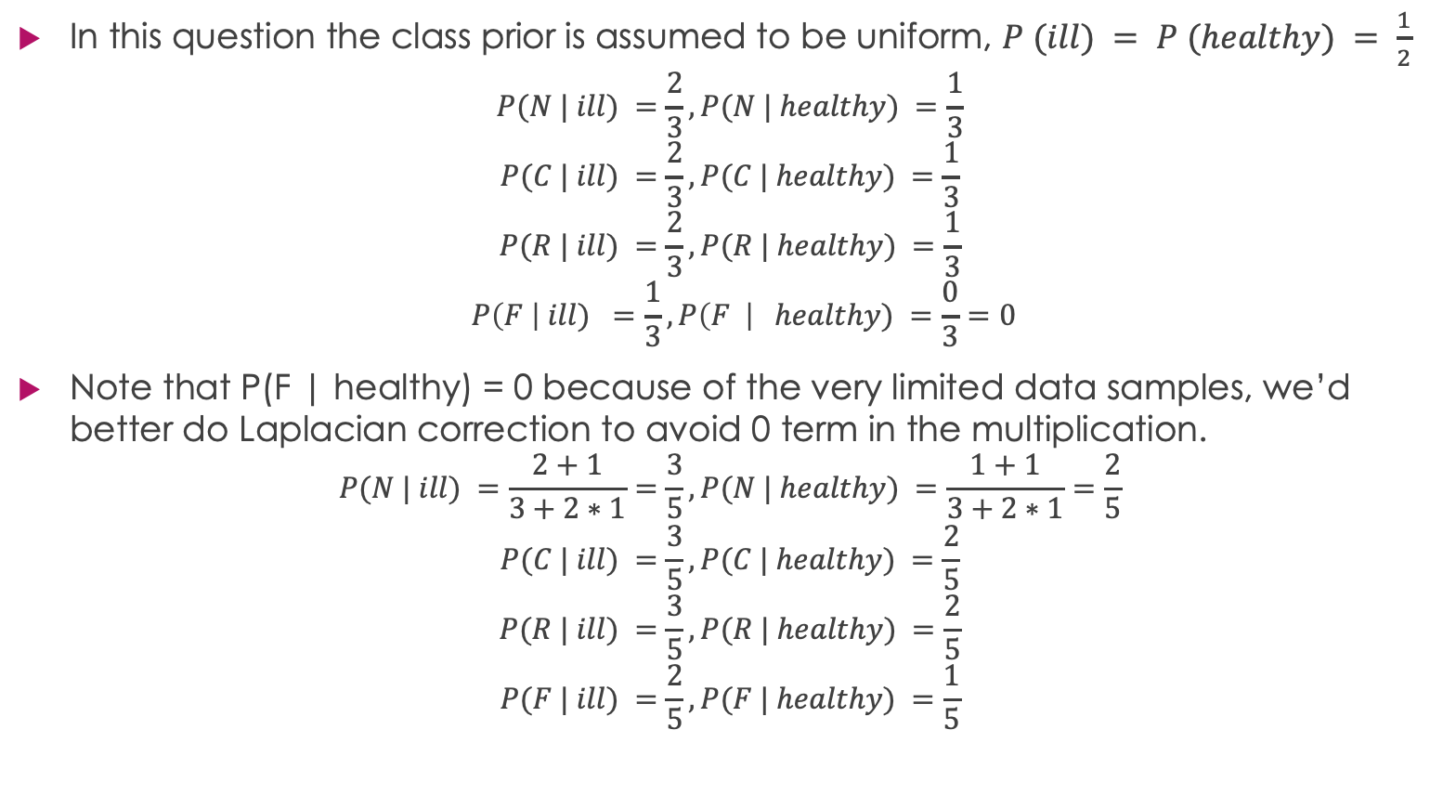
NBC Question Answer(1)
In this question the class prior is assumed to be uniform, $P (ill) = P (healthy) = \frac{1}{2}$
$$P(N | ill) =\frac{2}{3}, P(N | healthy) =\frac{1}{3}$$
$$P(C | ill) =\frac{2}{3}, P(C | healthy) =\frac{1}{3}$$
$$P(R | ill) =\frac{2}{3}, P(R | healthy) =\frac{1}{3}$$
$$P\left(F \right| ill) =\frac{1}{3},P\left(F \right| healthy) =\frac{0}{3}=0$$
Note that P(F | healthy) = 0 because of the very limited data samples, we’d better do Laplacian correction to avoid 0 term in the multiplication.
$$P(N | ill) =\frac{2+1}{3+2∗1}=\frac{3}{5}, P(N | healthy) =\frac{1+1}{3+2∗1}=\frac{2}{5}$$
$$P(C | ill) =\frac{3}{5}, P(C | healthy) =\frac{2}{5}$$
$$P(R | ill) =\frac{3}{5}, P(R | healthy) =\frac{2}{5}$$
$$P(F | ill) =\frac{2}{5}, P(F | healthy) =\frac{1}{5}$$

Slide 10

Laplacian correction (or Laplacian smoothing)
Laplace correction is a smoothing technique that handles the problem of zero probability in Naïve Bayes.
Using Laplace correction, we can represent P(w’|positive) as
Here, alpha represents the smoothing parameter, K represents the number of values in the data, and N represents the number of reviews with y=positive
If we choose a value of alpha!=0 (not equal to 0), the probability will no longer be zero even if a word is not present in the training dataset.
Most of the time, alpha = 1 is being used to remove the problem of zero probability.

Slide 11

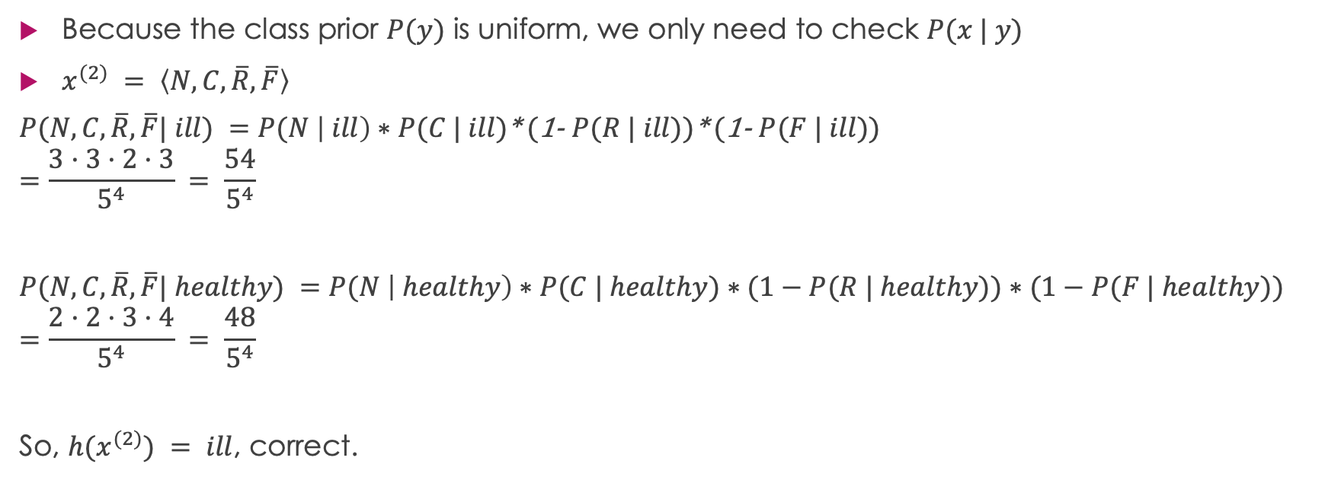
NBC Question Answer(2)
Because the class prior $P(y)$ is uniform, we only need to check $P(x | y)$
$x^{(2)} = \left\langle N, C, \overline{R},\overline{F}\right\rangle$
$P(N,C,\overline{R},\overline{F}| ill) =P(N \left| ill\right)∗P(C | ill)$* (1- $P(R | ill)$)* (1- $P(F | ill)$)
$$=\frac{3·3·2·3}{5^{4}} = \frac{54}{5^{4}}$$
$P(N,C,\overline{R},\overline{F}| healthy) =P(N \left| healthy\right)∗P(C | healthy)∗(1−P(R | healthy))∗(1−P(F | healthy))$
$$=\frac{2·2·3·4}{5^{4}} = \frac{48}{5^{4}}$$
So, $h(x^{(2)}) = ill$, correct.
$$P(N | ill) =\frac{3}{5}, P(N | healthy) =\frac{2}{5}$$
$$P(C | ill) =\frac{3}{5}, P(C | healthy) =\frac{2}{5}$$
$$P(R | ill) =\frac{3}{5}, P(R | healthy) =\frac{2}{5}$$
$$P(F | ill) =\frac{2}{5}, P(F | healthy) =\frac{1}{5}$$

